Slide 1
Testing Nonfunctional Requirements
– Review of Chapter 9
CSCN73010 for Bachelor of Computer Science Degree

Slide 2
Non-functional Requirements (NFR's)
What exactly is a non-functional requirement?
Functional vs. Non-functional can seem somewhat artificial
Functional – very clear to see having a basis in coded 'functionality' or structural characteristics
Non-functional – May be likened to 'system characteristics', which will include the impact of how the system is coded, along with the aggregate impact of external systems, multi-tiered architecture, network and OS dependencies, and so on.

Slide 3
About Nonfunctional Requirements (NFR's)
Functional requirements lead us to Verification – essentially the outcome that the coding met design specifications.
Non-functional requirements are dependent on a built system as a starting point. The aim is to Validate that the solution will ultimately meet user and stakeholder requirements while in use.
Functional req's can sometimes be met without compiling... Non-functional req's pretty much cannot be met without a built/live system to test

Slide 4
NFRs Can Go Unnoticed
Non-functional Requirements are sometimes dropped off project plan or go unnoticed early on in project.
Discovering late in delivery process that there is a security problem, or a performance bottleneck would delay a project or even get it cancelled.
Because architecture can’t be changed later in a delivery

Slide 5
Interaction between NFRs
NFRs interact with each other in an unhelpful matter.
Very secure systems often compromise on ease of use
Very flexible systems often compromise on performance

Slide 6
Assessing NFR's
What are the Limits? Measured how?
Details and more Details...
Response time should be as fast as possible.
Revised – All user interactions will take less than 2 seconds to respond.
When is an application performance goal a usability goal?
Does the 2 second target mean 2 seconds to execute the process, or does it mean you can respond in 2 seconds or less with 'Please wait, loading...'

Slide 7
As soon as possible, most of the times, etc
You have to be specific with your NFRs so you can test them !
No cap on a word like “as soon as possible”

Slide 8
Capacity, Throughput, Performance
Three elements of NFR testing

Slide 9
Terminology for NFR Testing
Capacity – Response time for individual requests is acceptable based on max throughput for a given workload. Linked to . . .
Throughput - Number of transactions that are processed in a unit of time
Performance - How long does it take to process a single transaction.

Slide 10
Measuring Capacity
Scalability testing. How do the response time of an individual request and the number of possible simultaneous users change as we add more servers, services, or threads?
Longevity testing. This involves running the system for a long time to see if the performance changes over a protracted period of operation. This type of testing can catch memory leaks or stability problems.
(Humble & Farley, 2011, p. 76)

Slide 11
Measuring Capacity
Throughput testing. How many transactions, or messages, or page hits per second can the system handle
Load testing. What happens to capacity when the load on the application increases to production-like proportions and beyond? This is perhaps the most common class of capacity testing..
(Humble & Farley, 2011, p. 76)

Slide 12
Activity:
You are part of a new startup that is developing a music streaming application.
Review the HP5 Studio activity provided on eConestoga to separate out the functional from the non-functional requirements for the product.

Slide 13

What is success in a NFR test?
Challenge – Test environments are often just a simulation of production; thus how far can you extend results from testing and hold that they will apply in production?
Challenge – Some production environments are too small, or perhaps too massively expensive to replicate on a 1:1 scale.
(Right - an old way of testing a helmet's protective capacity)

Slide 14
Developing success measures
Baseline everything - If you hope to be able to make inferences about capacity/throughput/performance you must know where we're starting to measure from, e.g. the original baseline performance. The creation of valuable quality test records is a good benefit of testing against baseline measures
Beware of scaling - It is a good strategy to develop a scaled approach to the test environment, but it is often rare to see test results scale 'perfectly' to production. Operational monitoring is critical in efforts to understand as much as possible about how the application works in production.

Slide 15
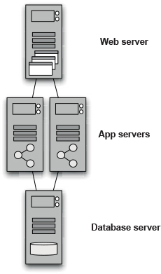
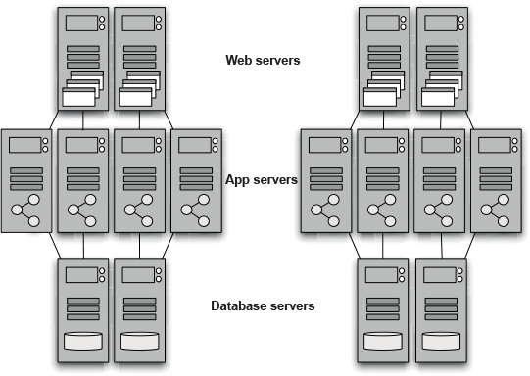
Scaling the test environment
Scaling
From Fig. 9.2 - Production Environment (left) scaled to a representative Test Environment (right)

Slide 16
Automating Capacity Testing
- Test specific real-world scenarios.
- Have a predefined threshold for success.
- Be of short duration.
- Avoid constant rework to keep up with changes.
- Be repeatable.

Slide 17
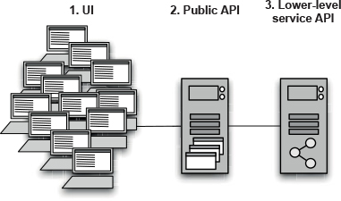

Where to test ?!
What could we test here??
From Fig. 9.3 - Potential injection points for capacity testing.

Slide 18
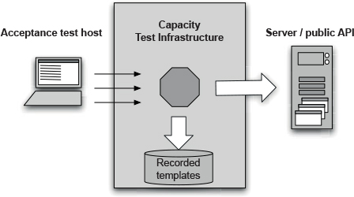
Selectively dividing the system
Bypass complexities of client-side scale out...
Your service API will act in the place of having 10,000 web clients sending calls to the web server.
Will you still need to test lots of actual clients against the system? Possibly but possibly not! Some architectures are well tested in this manner compared to production.
From Fig. 9.4 - Recording Interactions against a public API

Slide 19
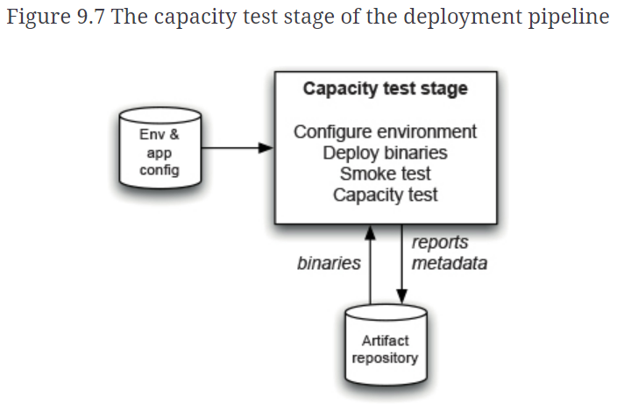
Pipeline view of Capacity Testing
Does this look familiar yet?
Important to note that the approach to including and supporting capacity testing in your CI/CD pipeline has many of the same goals as previous stages...
Configuration
Access to binaries
Smoke testing
Managing reports and metadata

Slide 20
Adding Capacity Test to Pipeline
- The good enough test.
- Make sure the system is not over-engineered vs not having enough capacity to handle the expected loads.
- Always remember, test should fail as quickly as possible to provide feedback.
- Best to have those tests after your acceptance tests ! Since they take longer to execute and not run every commit.
- Also, they need specialized environment to be set up.

Slide 21
Benefits of Capacity Test System
- Detect and debug memory leaks
- Longevity testing
- Tuning application configuration parameters
- Simulate worst-day scenario
- Load-testing communication with external systems.
- And much more.

Slide 22
Activity: Capacity Testing in Python !
Let’s try that on our code.

Slide 23
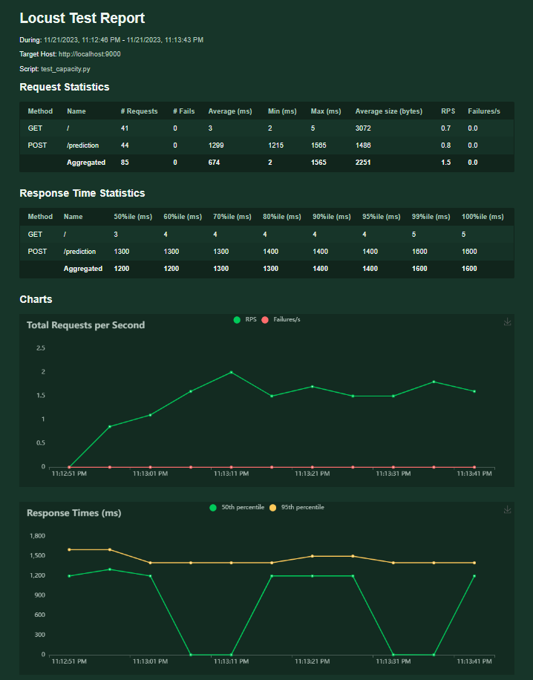
Locust Report

Slide 24
Capacity Testing in Python
Using Locust

Slide 25
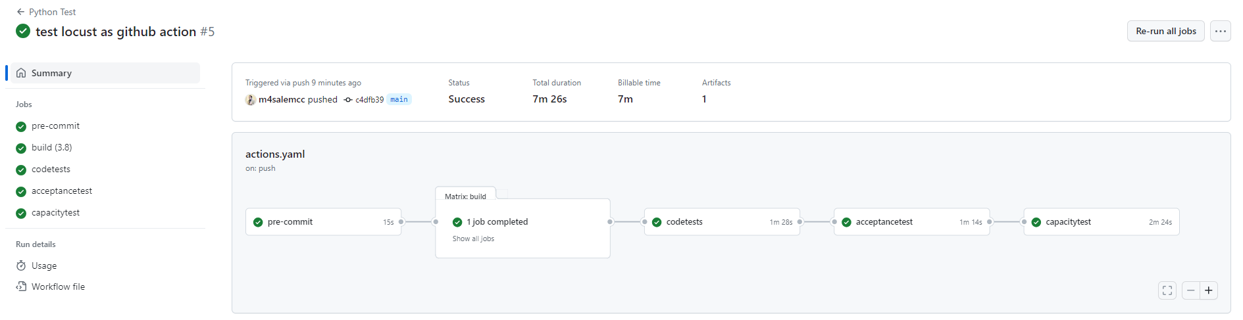
Github Action Workflow

Slide 26
Capacity Testing in Python
Locust as a github action !

Slide 27
Deploying and Releasing Applications –
Review of Chapter 10
CSCN73010 for Bachelor of Computer Science Degree

Slide 28
Wow – we have to worry about this?
While in school, you don't typically deploy many of your assignments to 'production', aside from uploading to a drop box
For real world deployments, we need to wonder about...
  Archiving and backup strategy
  Data migration
  Communicating dev/support features like logging or debug modes
  Impact to external systems... have the Operations team been informed of possible impact to delivery?
  And MANY more topics!!

Slide 29
What others in the company are thinking about as we approach release of the app
Pricing model & Licensing strategy
Copyright issues around third-party technologies used
Packaging & Marketing materials—print, web-based, podcasts, blogs, press releases, conferences, etc.
Product documentation and/or wiki's
Installers
Preparing sales and support teams

Slide 30
Release Plan
The steps required to deploy the application for the first time
How to smoke-test the application and any services it uses as part of the deployment process
The steps required to back out the deployment should it go wrong
The steps required to back up and restore the application’s state
The steps required to upgrade the application without destroying the application’s state

Slide 31
More in a Release Plan
The steps to restart or redeploy the application should it fail
The location of the logs and a description of the information they contain
The methods of monitoring the application
The steps to perform any data migrations that are necessary as part of the release
An issue log of problems from previous deployments, and their solutions

Slide 32
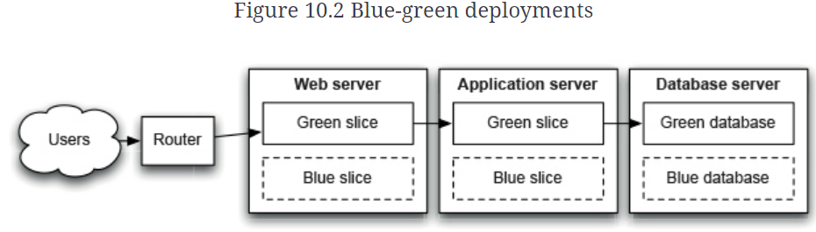
Sample Zero Downtime Release
- Blue-Green Deployments

Slide 33
Blue-Green Deployments
Think about database situation; might be set to read-only for a short time. Snapshots might be taken in case of rollback.
Might be costly to have the capacity of having two environments at the same time.

Slide 34
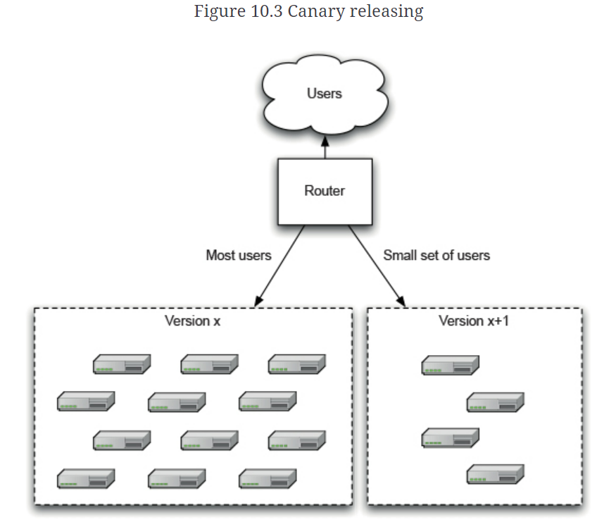
Sample Zero Downtime Release
- Canary Releasing

Slide 35
Canary Releasing
Usually applied to power users; can utilize A/B testing.
Can check capacity requirements by ramping up the load by adding more and more users.
Did you experience this before ?

Slide 36
Always be ready to revert!
While there are many good tips and tricks shared in our course text and out in the industry, those with many years' experience will tend to align with one essential goal for releasing a new version of a software system...
ALWAYS HAVE A BACKUP
(Related – test that your backup strategy is valid and works!!)

Slide 37
More Tips ..
Don’t delete old files, move them.
Have warm-up period for new deployments.
Don’t make changes directly to production environment.
Hotfixes go through the same release process.
Still follow your process even in emergencies.

Slide 38
Activity:
Catch up for activities in previous lectures.
Help debugging issues in your development environment.

Slide 39

Assignment 4 Check In

Slide 40

Thank you !

